Slide 1

COVIDgilance Presented by Paul Kazalski, Flomo Kokro, Will Giordano, Maria-Elena Gorini, Meghna Agnish

Slide 2

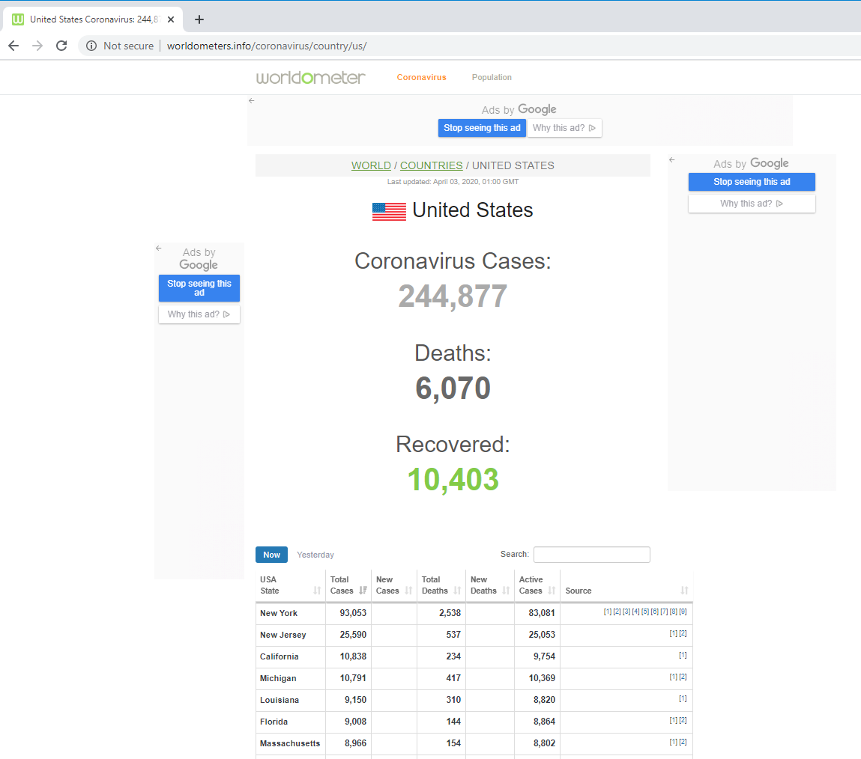
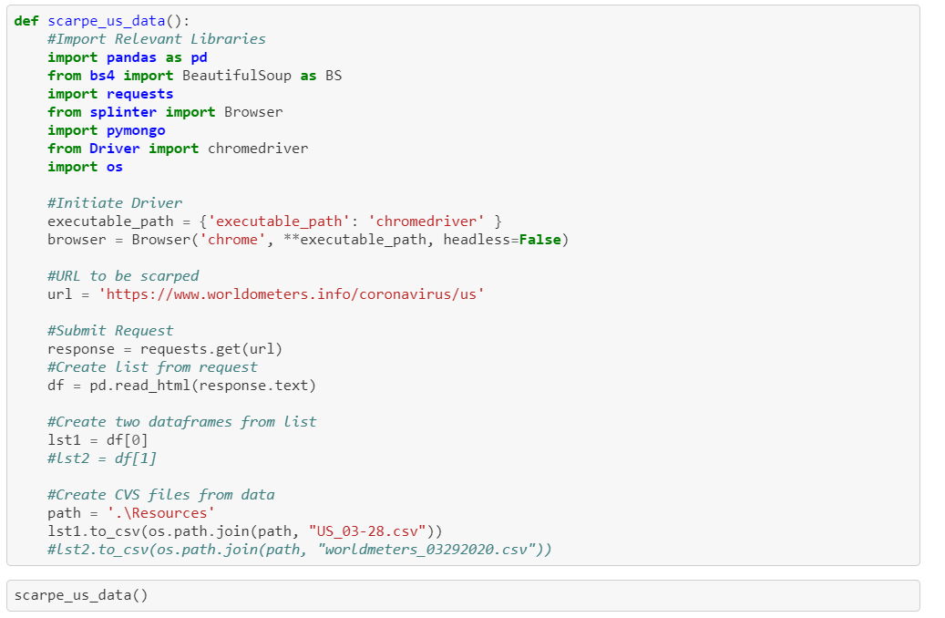
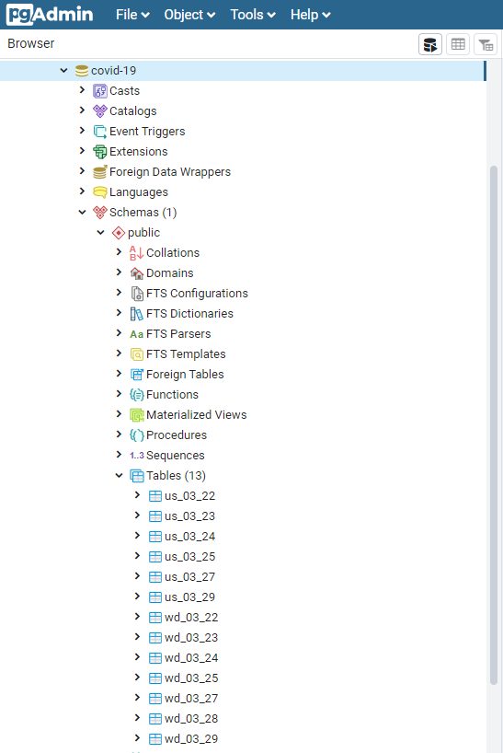
Data
Data came from worldometers.info/coronoavirus
Each US file had 54 lines of data. Each World file had 202 lines of data.
We pulled data from March 22, 2020 to April 1, 2020 (11 days of data).

Slide 3
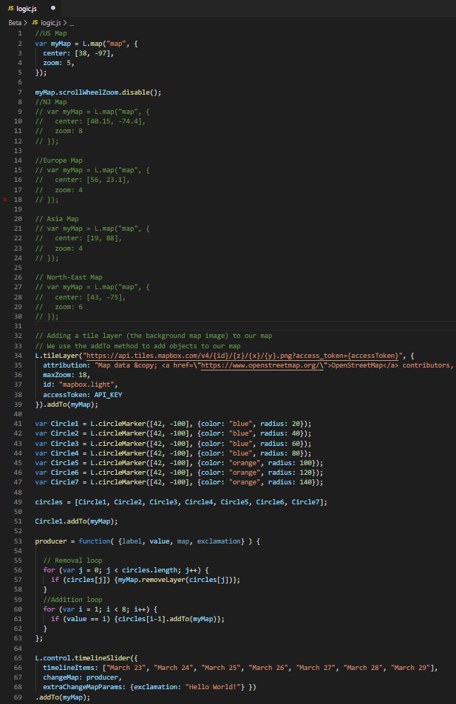
Javascript File 1
Creates:
The map
Links the slider library to the circles and updates the circles based on the date
Utilized:
Map-box
Leaflet
Slider Library

Slide 4
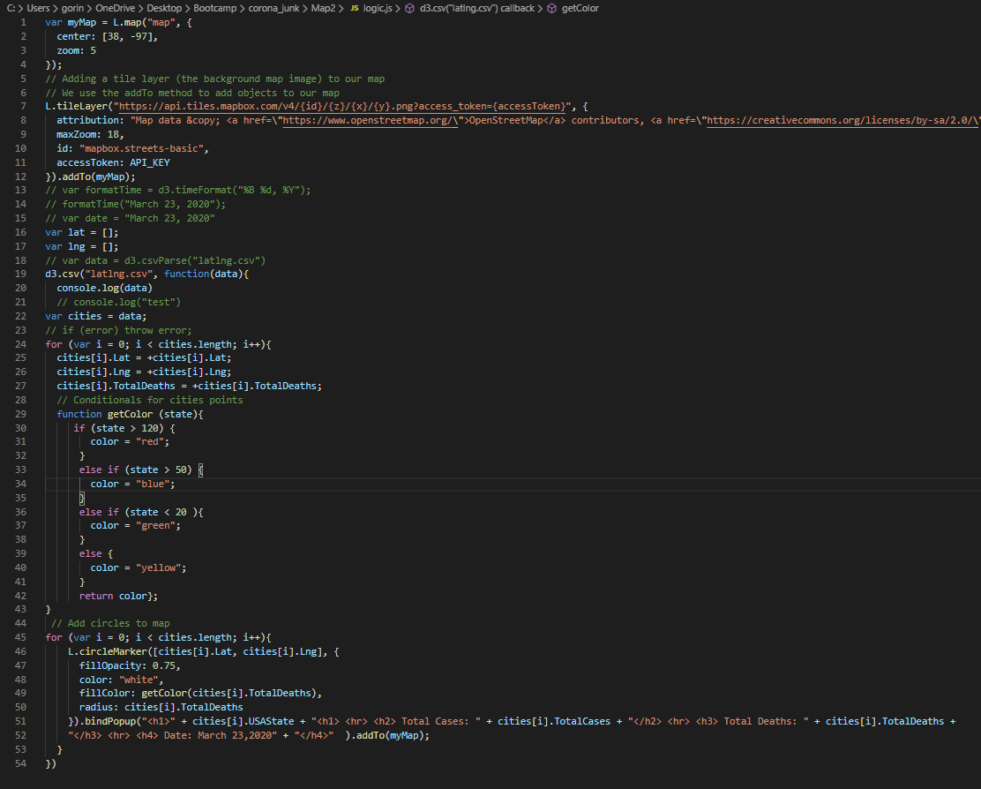
Javascript File 2
Creates:
Circles based on the number of total cases and total deaths
Utilized:
The API that was utilized was implemented by Map-box
Leaflet
Scraped Data

Slide 5
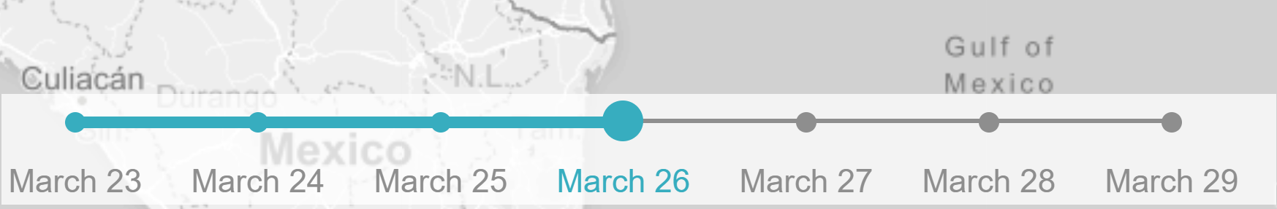
Leaflet timeline-slider
Who we should thank:
Created by Sol Vitkin (GitHub: svitkin)
Maintained by Dennis Wilhelm
What it is:
A time-based interaction overlay
(from leafletjs.com ToC)
L.control.timelineSlider({ })
How it works:
generates the interactive slider icon (with customization options)
allows the user to attach a function related to said slider
accepts additional functions not related to slider value
Other options:

Slide 6
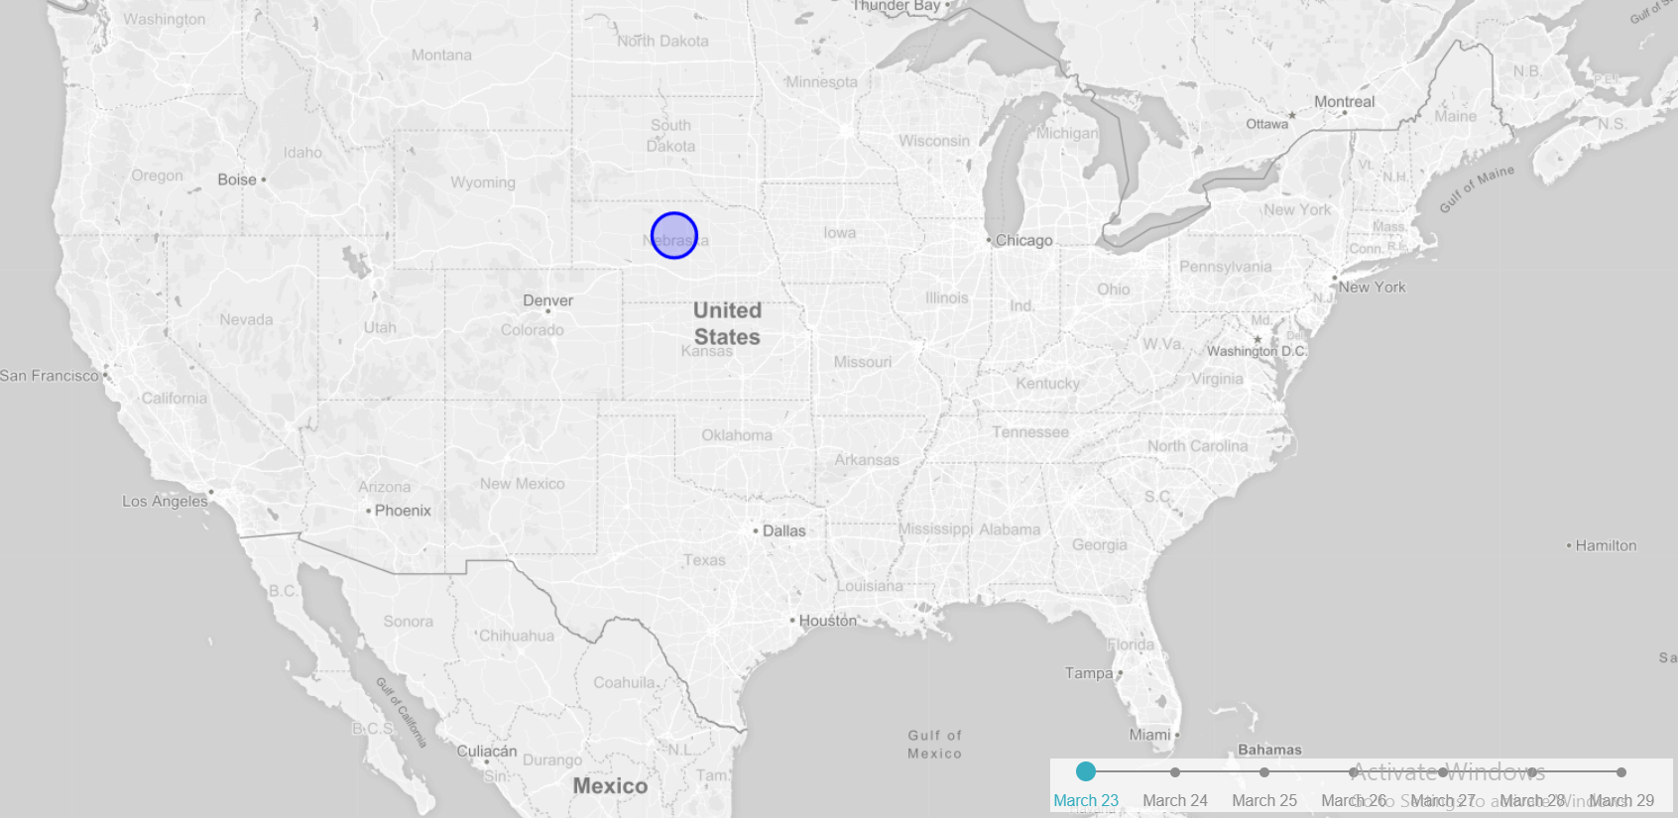
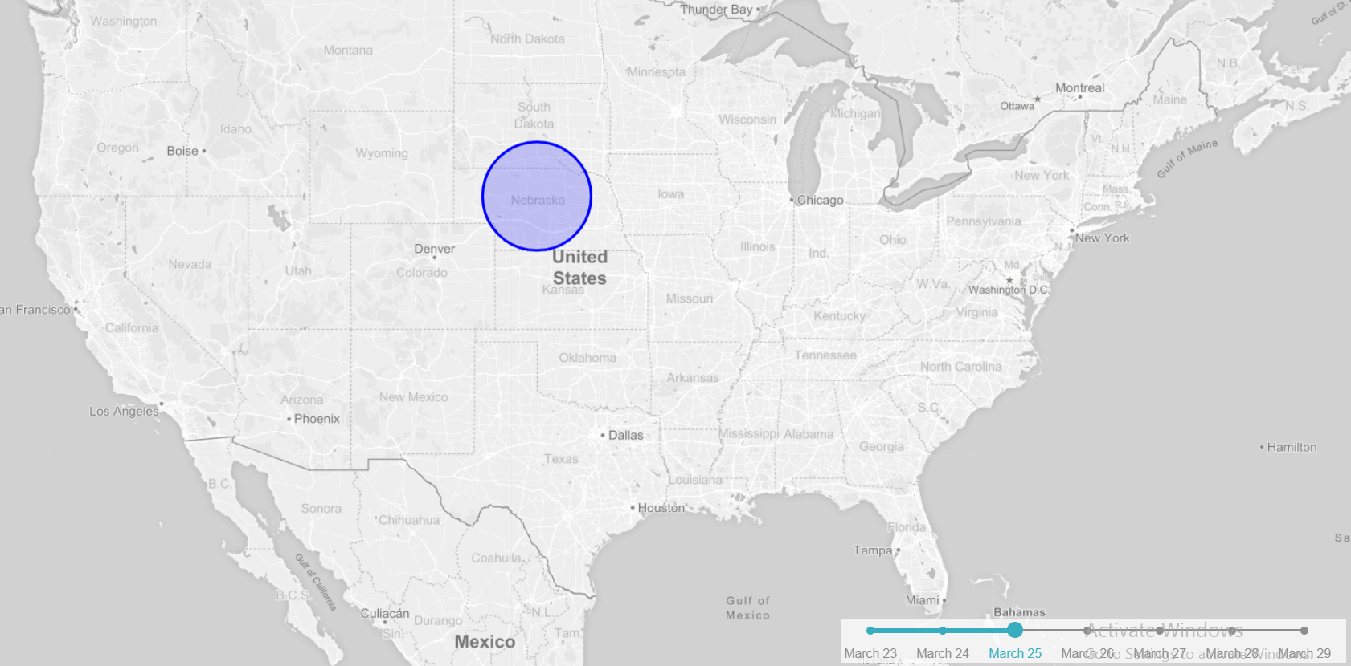
Timeline-slider Example
producer = function( {label, value, map, exclamation} ) {
for (var j = 0; j < circles.length; j++) {
if (circles[j])
{myMap.removeLayer(circles[j])};}
for (var i = 1; i < 8; i++) {
if (value == i)
{circles[i-1].addTo(myMap)};}
};
L.control.timelineSlider({
timelineItems: ["March 23", "March24",
"March 25", "March 26", "March 27",
"March 28", "March 29"],
changeMap: producer,
extraChangeMapParams: {exclamation: "Hello World!"}
}).addTo(myMap);

Slide 7
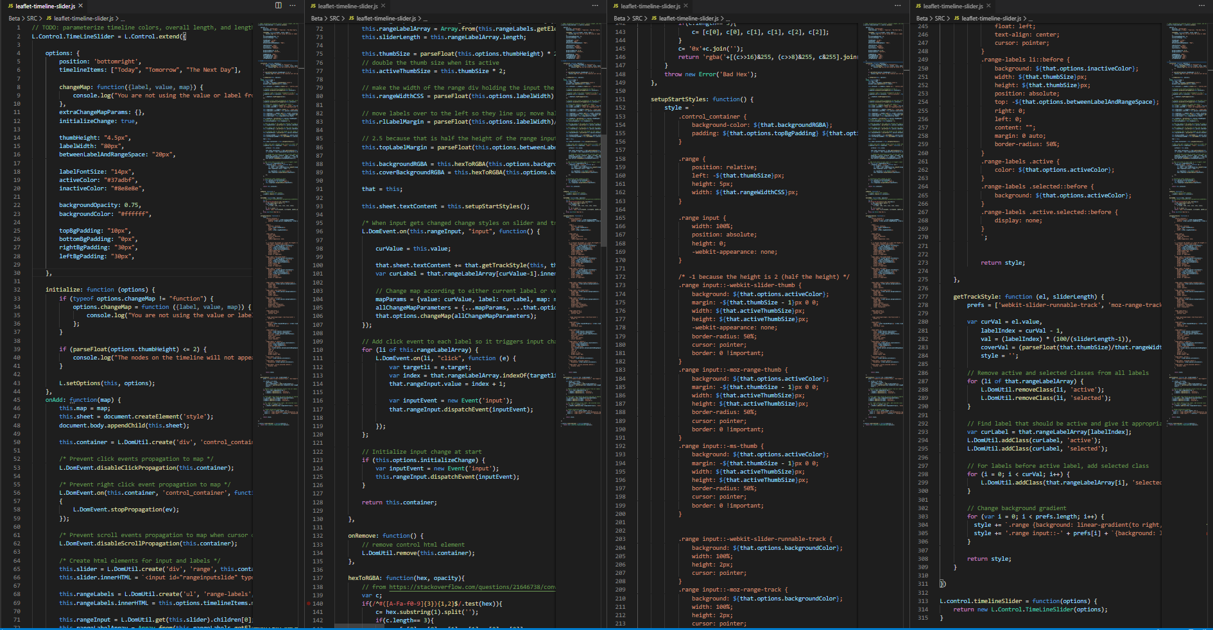
Slider Library

Slide 8
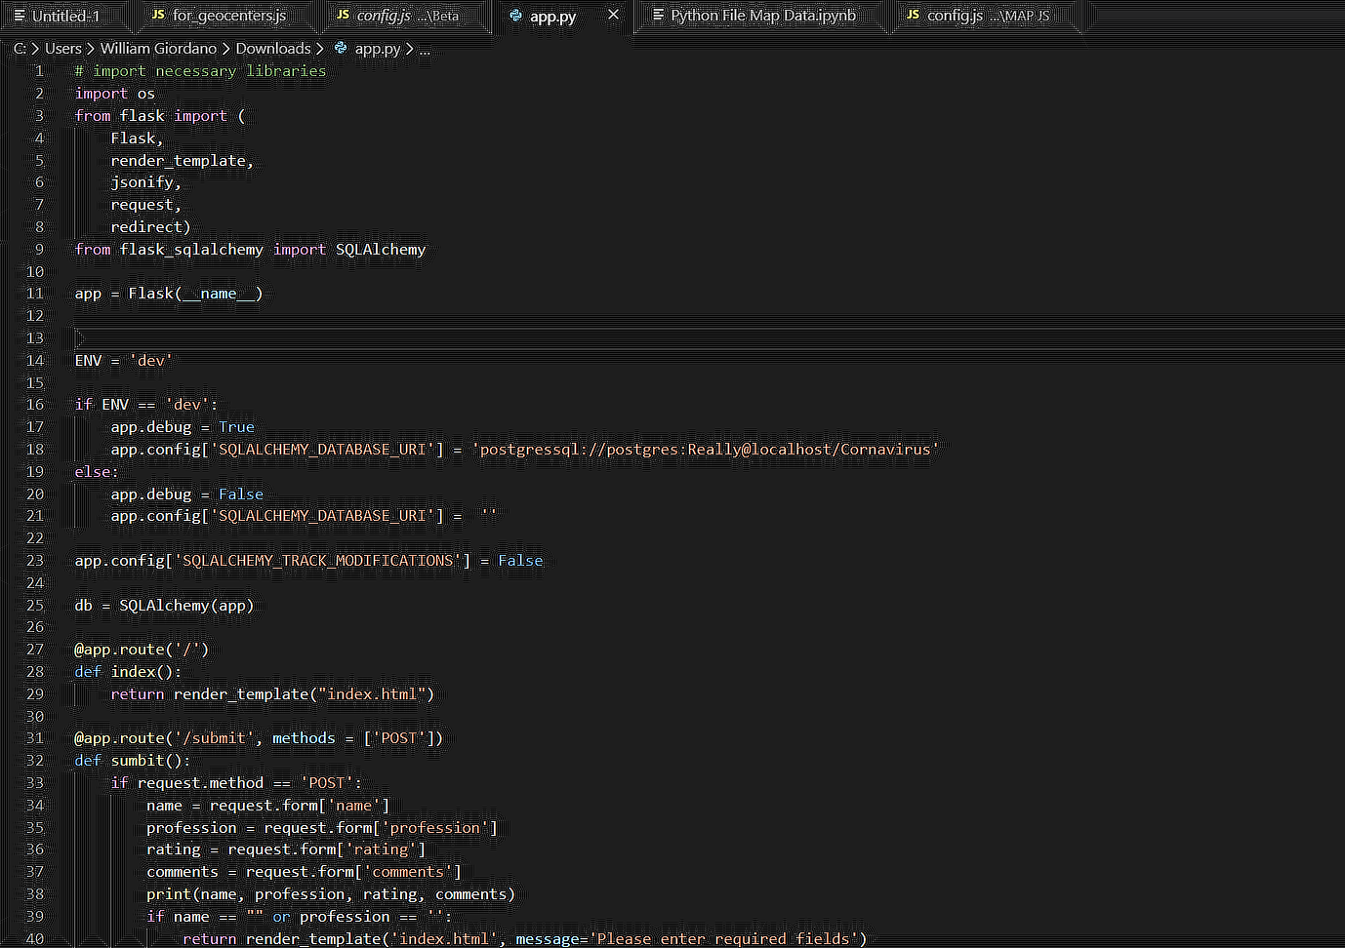
Flask File 1
Creates:
Web Application
Sharing information between CSS, Python and HTML
SQLAlchemy is used to store data

Slide 9
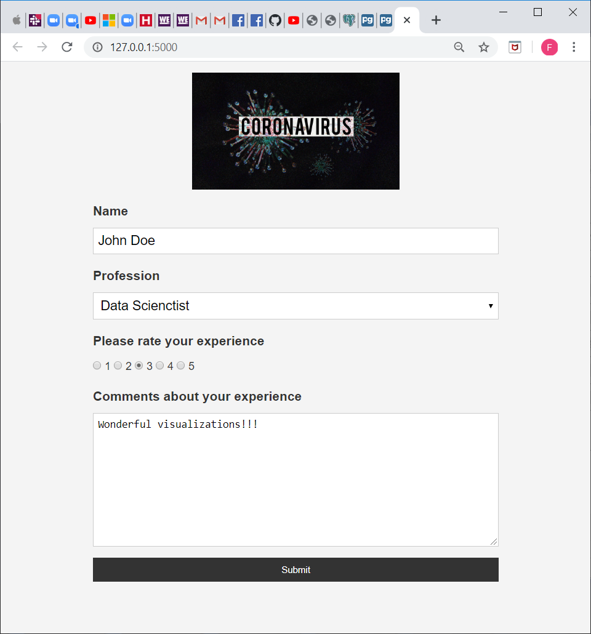
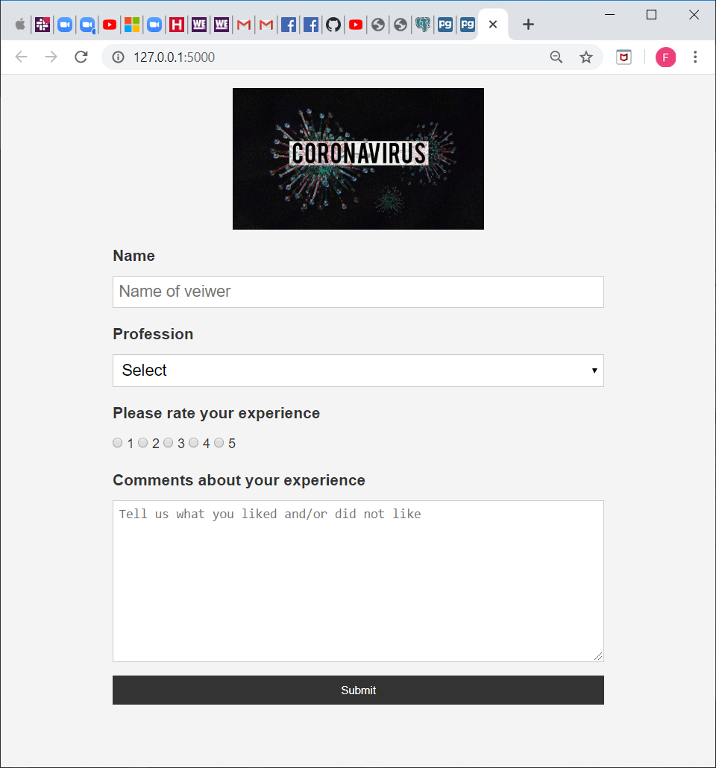
Flask File 2
Feedback app powered by Flask
User input data – stored in postgress

Slide 10
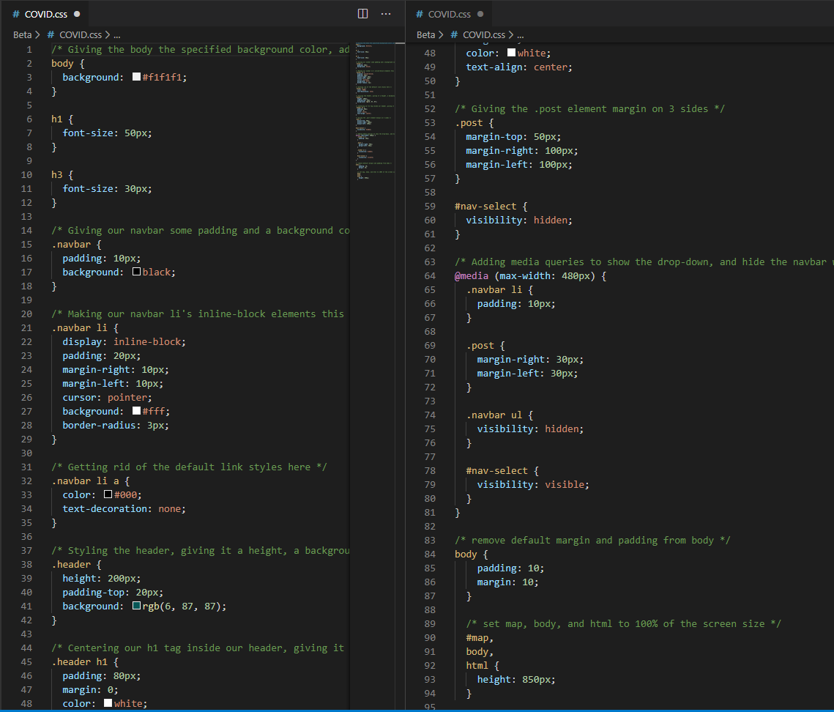
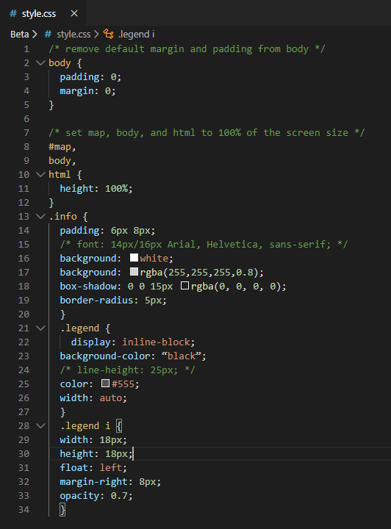
CSS

Slide 11
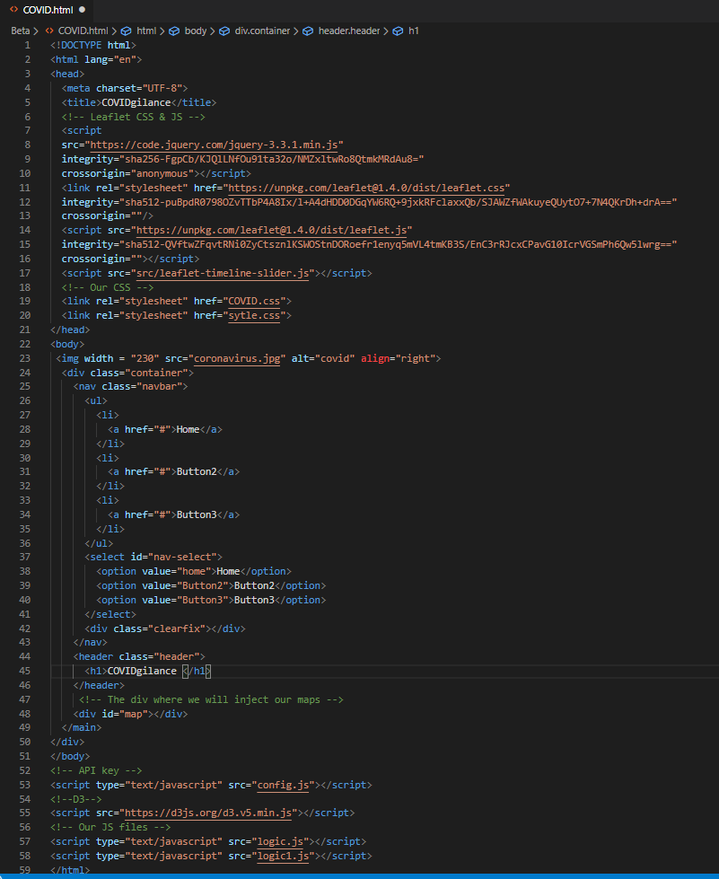
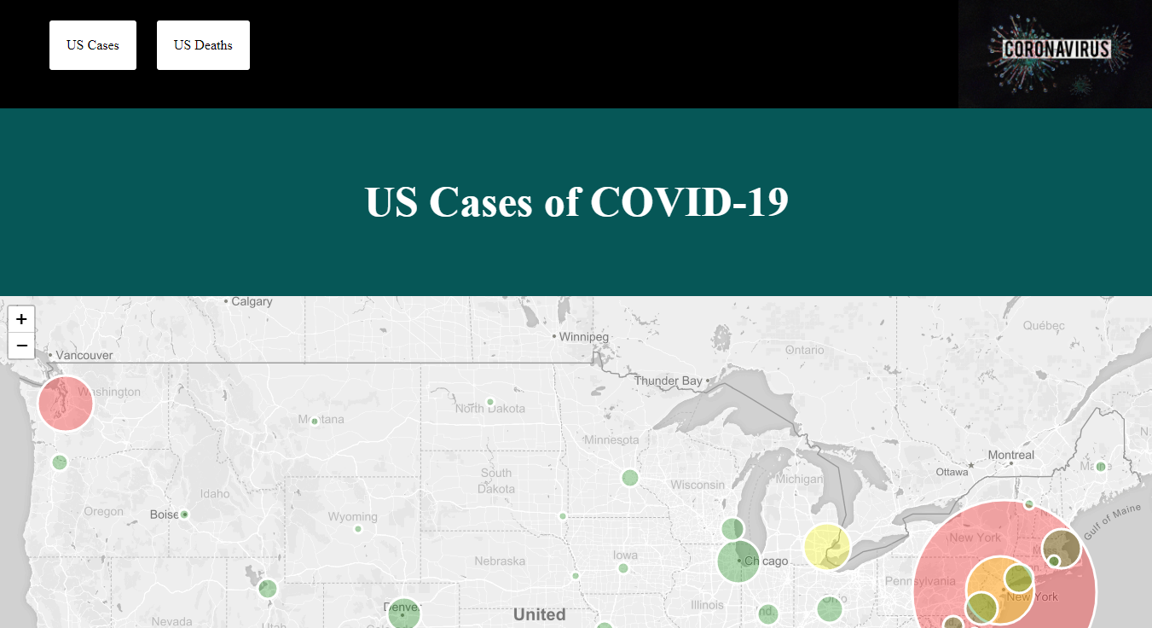
HTML

Slide 12
Conclusions
In our project we included code utilizing Web Scraping, Leaflet, Python-Flask, API, HTML, CSS, SQL, JavaScript, and Jupyter Notebook
Exponential Growth of the COVID-19 virus was concentrated in areas of New York state, New Jersey, and other city metropolis nationwide.

Slide 13

Questions
(No Coughing Please)

